Slide 1
Microsoft Azure Training Day: Bring your app to the next level with Serverless

Slide 2
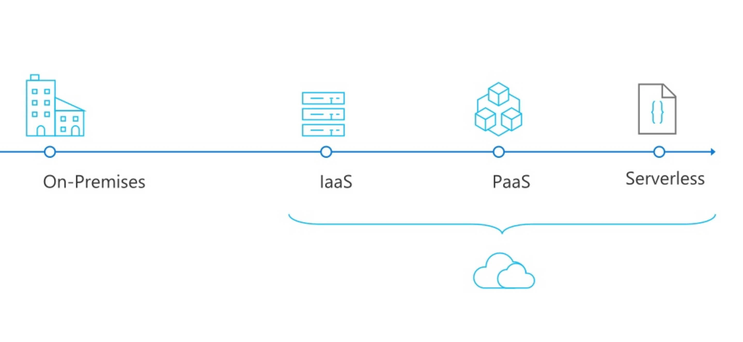
From traditional to modern apps

Slide 3
What is Serverless?
$
Abstraction of servers
Event-driven/ instant scale
Micro-billing

Slide 4


What are the benefits?
Solve business problems—not technology problems related to undifferentiated heavy lifting
Focus
Shorter time to market
Fixed costs converted to variable costs
Better service stability
Better development and testing management
Less waste
Efficiency
Simplified starting experience
Easier pivoting means more flexibility
Easier experimentation
Scale at your pace—don’t bet the farm on Day 1
Natural fit for microservices
Flexibility

Slide 5
Scenarios for Serverless
Anything that needs to respond to events
Real-time stream processing
Timer-based processing
Millions of devices feed into Stream Analytics
Transform to structured data
Store data in SQL DB
Every 15 minutes
Find and clean invalid data
Clean table
Backends (Mobile/IoT/Web)
Real-time bot messaging
?
...
Photo taken and WebHook called
Stores in blob storage
Produces scaled images
Message sent to Chatbot
Chatbot sends
response
Cortana Analytics answers questions

Slide 6
The shared responsibility model
Physical security
Host infrastructure
Operating system
Network controls
Identity & access management
Logical application server
Application logic
Client endpoints
Data classification
On-prem
IaaS
PaaS
Serverless
SaaS
Cloud provider
Cloud customer

Slide 7









Azure Serverless platform for event-driven apps
Development
Platform
IDE support
API Management
Event Grid
Functions
Logic Apps
Integrated DevOps
Manage all events that can trigger code or logic
Execute your code based on events you specify
Design workflows and orchestrate processes
Local development
Monitoring
Database
Storage
Automation
Intelligence
Security
IoT
Visual debug history

Slide 8
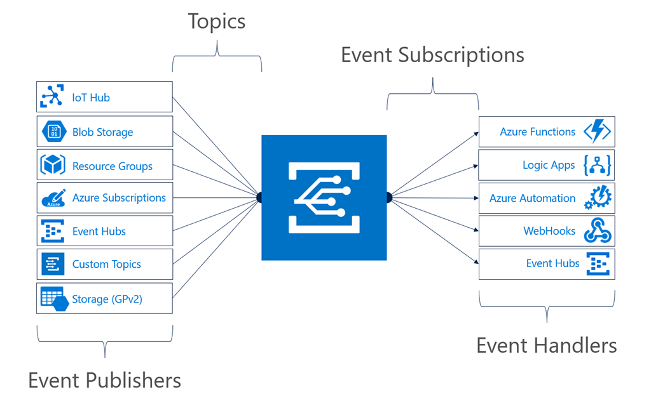
Event Grid
Fully managed event routing service that simplifies the development of event-based applications.
Enables customers to easily react to Azure and custom events
Delivers millions of events at scale
Provide multiple ways of reacting to event including serverless compute
Makes it easy to react to Azure native events and build modern apps anywhere, on-premises and cloud. This is unique to Azure Event Grid.

Slide 9

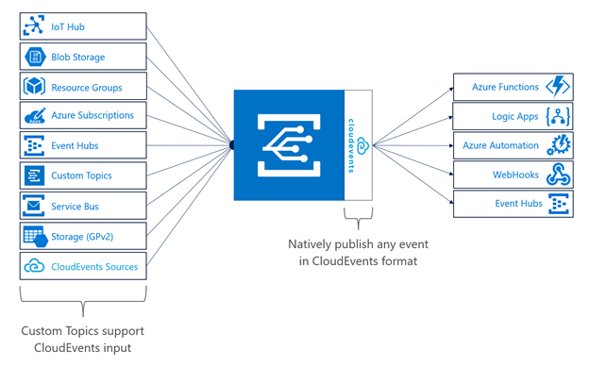
Cloudevents v0.1
An open standard for describing events in a common way
Currently incubated in CNCF’s Serverless Working Group
Active Contributors: Microsoft, Google, IBM, Huawei, VMWare, Iguazio, Red Hat, Serverless Inc., SAP, Collinson Group, Pivotal
Normalize events across environments
Facilitate integration across platforms
Increase portability of functions
Normalize webhooks

Slide 10
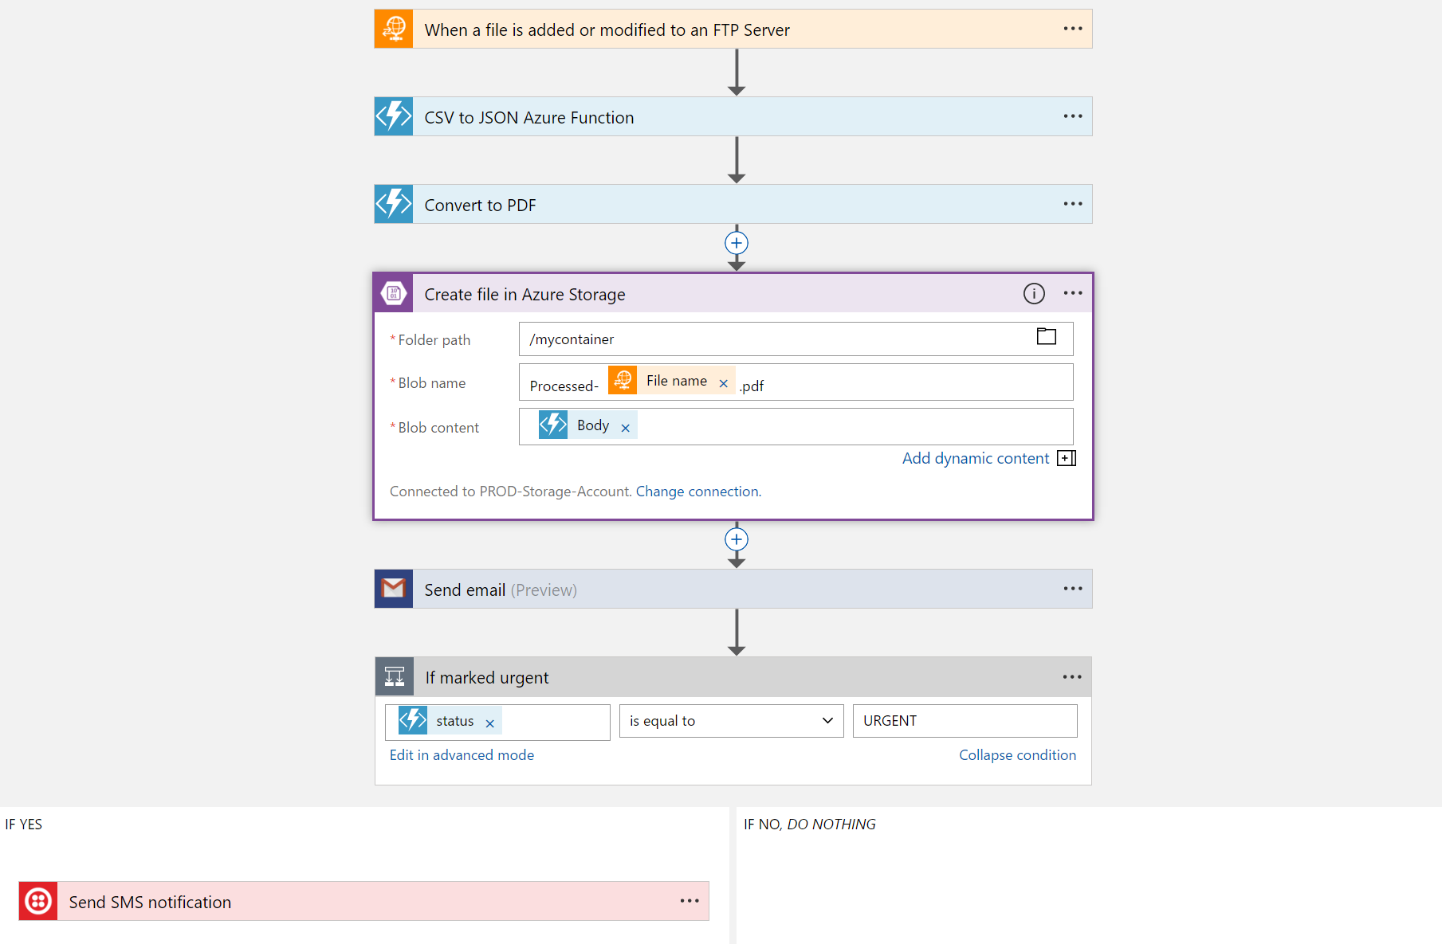
Logic Apps
Visually design workflows in the cloud
Express logic through powerful control flow
Connect disparate functions and APIs
Utilize declarative definition to work with CI/CD
Over 180 Connectors – Dropbox, Facebook, GitHub, Box, Twitter, Salesforce and more

Slide 11
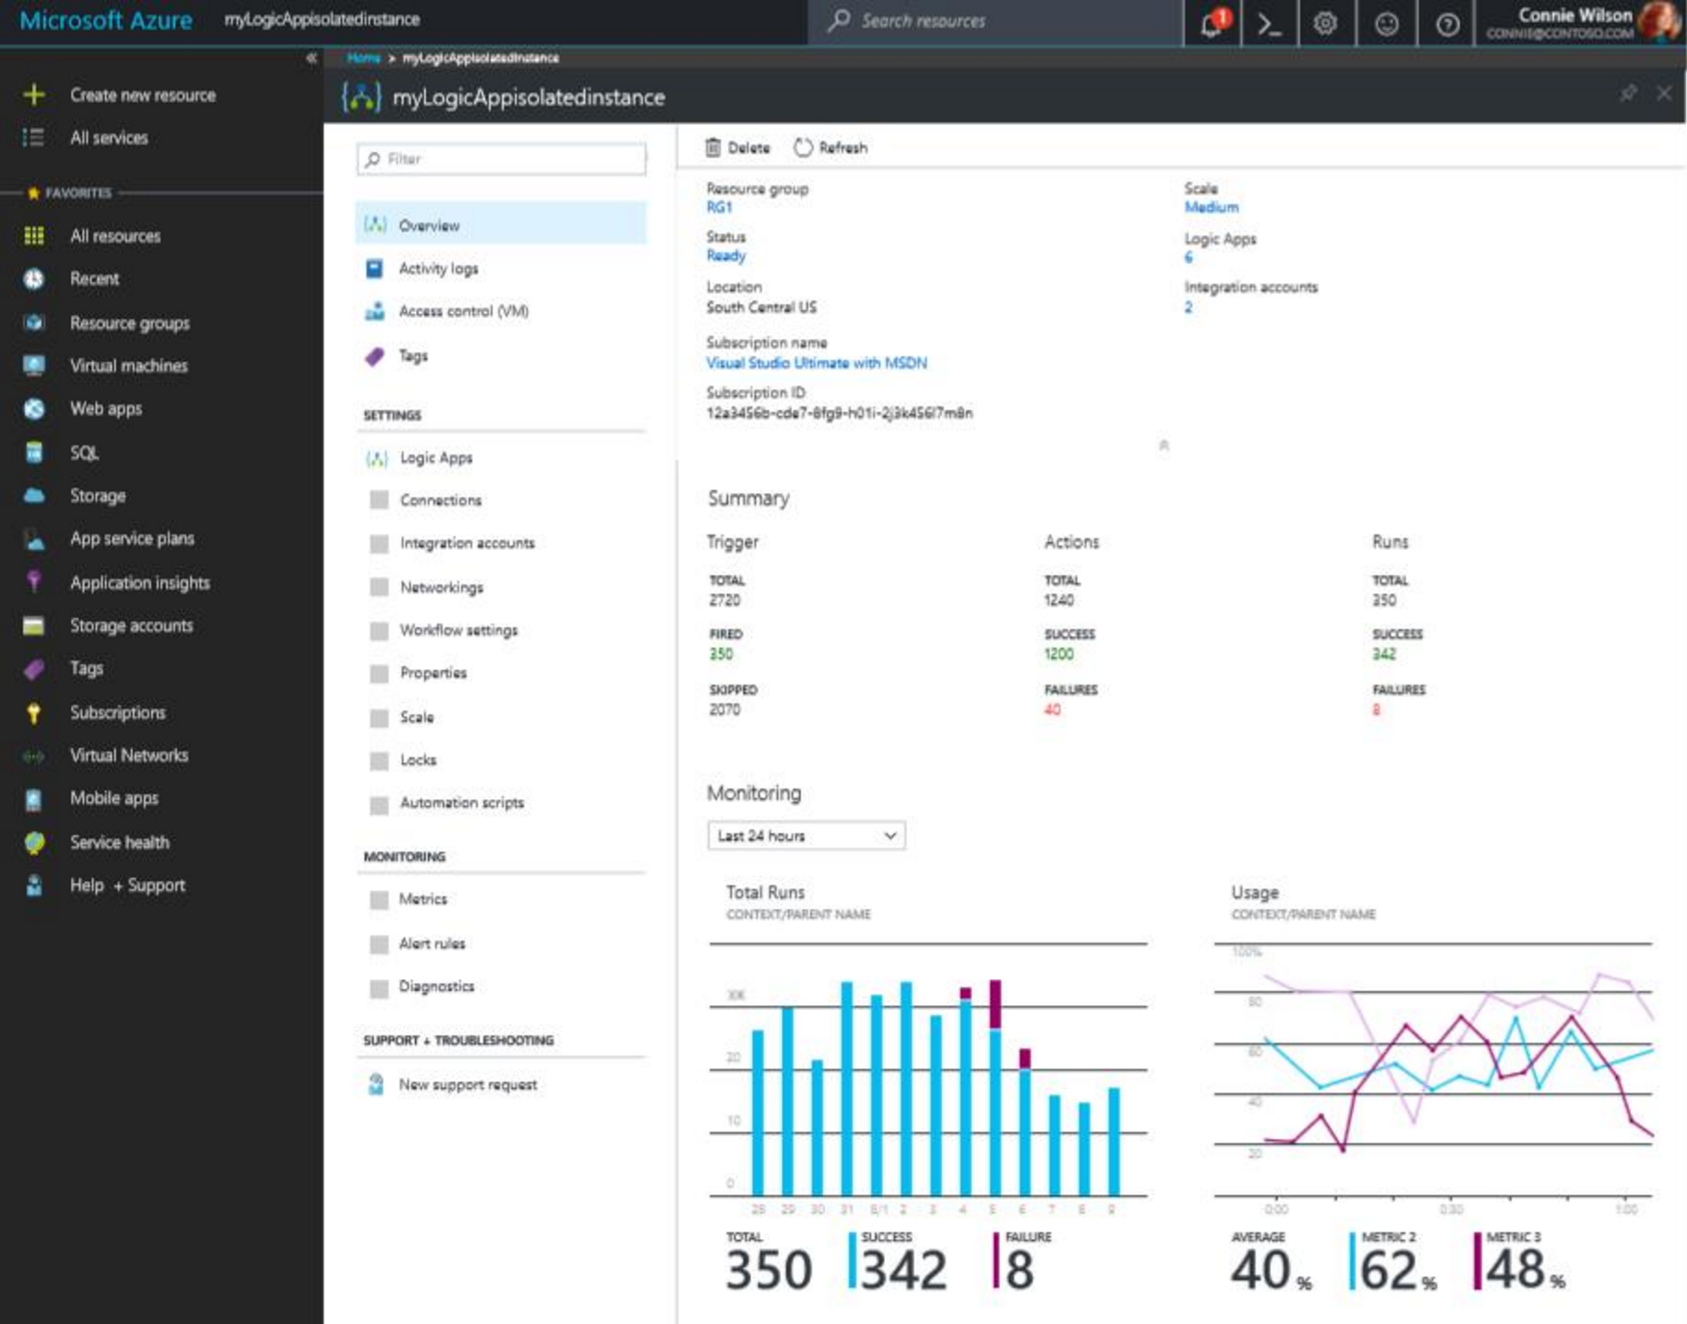
Logic Apps
ISE Preview
Public Preview Logic Apps Isolated
The new Logic Apps Isolated introduces unique capabilities, providing a fully isolated and dedicated environment for all enterprise-scale integration needs.
Key advantages of Logic Apps isolated provides:
Direct connection to on-premises resources (VNET, Express Route connectivity)
Consistent performance with dedicate capacity, isolated storage
Predictable pricing with Premium Integration Account and Enterprise Connections included
https://azure.microsoft.com/en-us/services/logic-apps/

Slide 12









Azure Functions
Azure Functions
Events
Code
Outputs
React to timers, HTTP, or events from your favorite Azure services, with more on the way
Author functions in C#, F#, Node.JS, Java, Python, PowerShell, and more
Send results to an ever-growing collection of services

Slide 13





Language options
Generally available
Public preview
Coming soon
Release Candidate
More on the way!

Slide 14
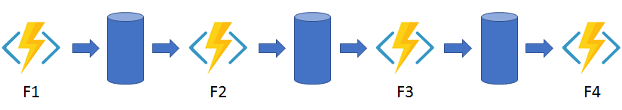
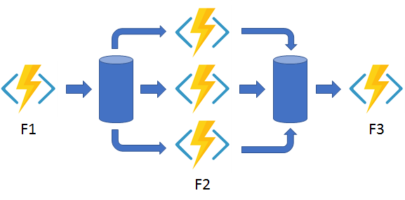
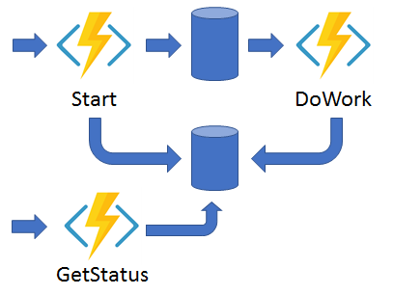
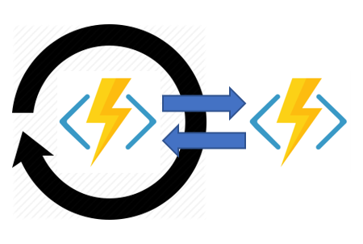
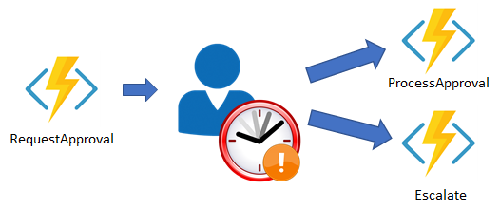
Azure Functions
Durable Functions
stateful functions in a serverless environment
Function chaining
Fan-out/Fan-in
Async HTTP APIs
Monitoring
Human Interaction

Slide 15













Functions everywhere
https://github.com/azure/azure-functions-host
(+other repos)
Azure Functions host runtime
Azure Functions Core Tools
Azure Functions base Docker image
Azure Functions .NET Docker image
Azure Functions Node Docker image
●●●
Development
Hosting
Local dev machine
Azure Functions
service
Azure Functions service
Azure Functions
service
IoT devices
Additional Azure hosts
Non-Azure hosts
On-premises
Platform
+
●●●
●●●
●●●
Core Tools + favorite editor
Consumption plan
App Service plan
Premium plan
Azure IoT Edge
AKS, …
K8s, raw VMs, & more
App Service on Azure Stack
App delivery
Code or container
Code
Code or container
Code
Container
Container
Container
Code
OS
Windows, macOS, or Linux
Windows or Linux
Windows or Linux
Windows
Linux
Linux
Linux
Windows

Slide 16
Recent announcements
Azure Functions 2.0 GA
Security updates (expanded managed identities, Key Vault references, and more)
Linux Consumption plan public preview
Premium Plan
Java RC
PowerShell private preview

Slide 17
Premium – Dedicated Workers
Plan Controls
Plan Size (starting)
Maximum Workers
App Controls
Always-On
Reserved Instances
Allows you to control density

Slide 18
Premium – Dedicated Workers

Slide 19
Premium – Dedicated Workers

Slide 20
Premium – Dedicated Workers

Slide 21
Elastic Premium Features
Reserved Instances → No Cold Start
Configurable max & min scale
Configurable instance size
P1v2 to P3v2
VNET Connectivity
Unlimited Run Duration

Slide 22
Spot the vulnerability!
module.exports = function (context, payload) {
if (payload.action != "opened") {
context.done();
return;
}
var comment = { "body": "Thank you for your contribution! We will get to it shortly." };
if (payload.pull_request) {
var pr = payload.pull_request;
context.log(pr.user.login, " submitted PR#", pr.number, ": ", pr.title);
SendGitHubRequest(pr.comments_url, comment, context); // posting a comment
}
context.done();
};
function SendGitHubRequest(url, requestBody, context) {
var request = require('request');
var githubCred = 'Basic ' + 'mattchenderson:8e254ed4';
request({
url: url,
method: 'POST',
headers: {
'User-Agent': 'mattchenderson',
'Authorization': githubCred
},
json: requestBody
}, function (error, response, body) {
if (error) {
context.log(error);
} else {
context.log(response.statusCode, body);
}
});
}

Slide 23




Secrets management
const msRestAzure = require('ms-rest-azure');
const KeyVault = require('azure-keyvault');
const vaultUri = process.env['GITHUB_SECRET_URI'];
// Value looks like: 'https://foo.vault.azure.net/secrets/gh'
//... Getting the event
let kvToken = msRestAzure.loginWithAppServiceMSI({
resource: 'https://vault.azure.net'
});
let keyVaultClient = new KeyVault.KeyVaultClient(kvToken);
keyVaultClient.getSecret(vaultUri).then(function (secret){
var githubHeader = 'Basic ' + secret;
//... Call GitHub
});

Slide 24
The deployment side
Outer Loop
Build and Test (CI)
Deploy
(CD)
Run
(Prod)
Inner Loop
Source Control
Monitoring and Diagnostics
Code,
Run,
Debug

Slide 25


Getting code to the cloud
CD
CD
“right-click publish”
CI
check-in
check-in
Direct publish
App Service SCM (Kudu)
CI/CD tools

Slide 26
Demo
Notes:
Create serverless greeting API (5 min demo):
Open VSCode (with Azure Functions ext installed)
Bring up the command palette (Ctrl+Shift+P) and type "Functions", the command palette will filter the list to show available comands for Azure Functions.
Select "Create Function..." command and select the local directory (default) to create your function app. Since there is no Function project created yet, you will be asked to initialize it, click "Yes".
Pick language of choice (JS is fastest compile so use that)
Select HTTP trigger and take default name
Pick Anonymous auth level and explain the difference
Select “Add to workspace”
Once the function has been created:
Run it the debugger by running “Attach to Node Function” and show the local dev experience and logs
Cmd+click on the url in the VS Code log (e.g. http://localhost:7071/api/HttpTrigger)
Your browser will open with an error, we need to add API params “?name=YOUR_NAME” (http://localhost:7071/api/HttpTrigger?name=Vadim)
You now have a serverless greeting API that you can deploy to Azure (time permitting)

